Slide 1
MARKER-ASSISTED BREEDING in APPLE, PEACH, & CHERRY TARGETS VALUABLE FUNCTIONAL ALLELES
Cameron Peace, Washington State University
with: Nahla Bassil, Michael Coe, Gennaro Fazio, Karina Gallardo, Ksenija Gasic, Jim Luby, Dorrie Main, Jim McFerson, Cholani Weebadde, Eric van de Weg, Chengyan Yue, & Amy Iezzoni

Slide 2
Outline of Presentation
The RosBREED Project
Available “Jewels in the Genome”
Jewels in Breeding Application
What’s Next? RosBREED 2

Slide 3
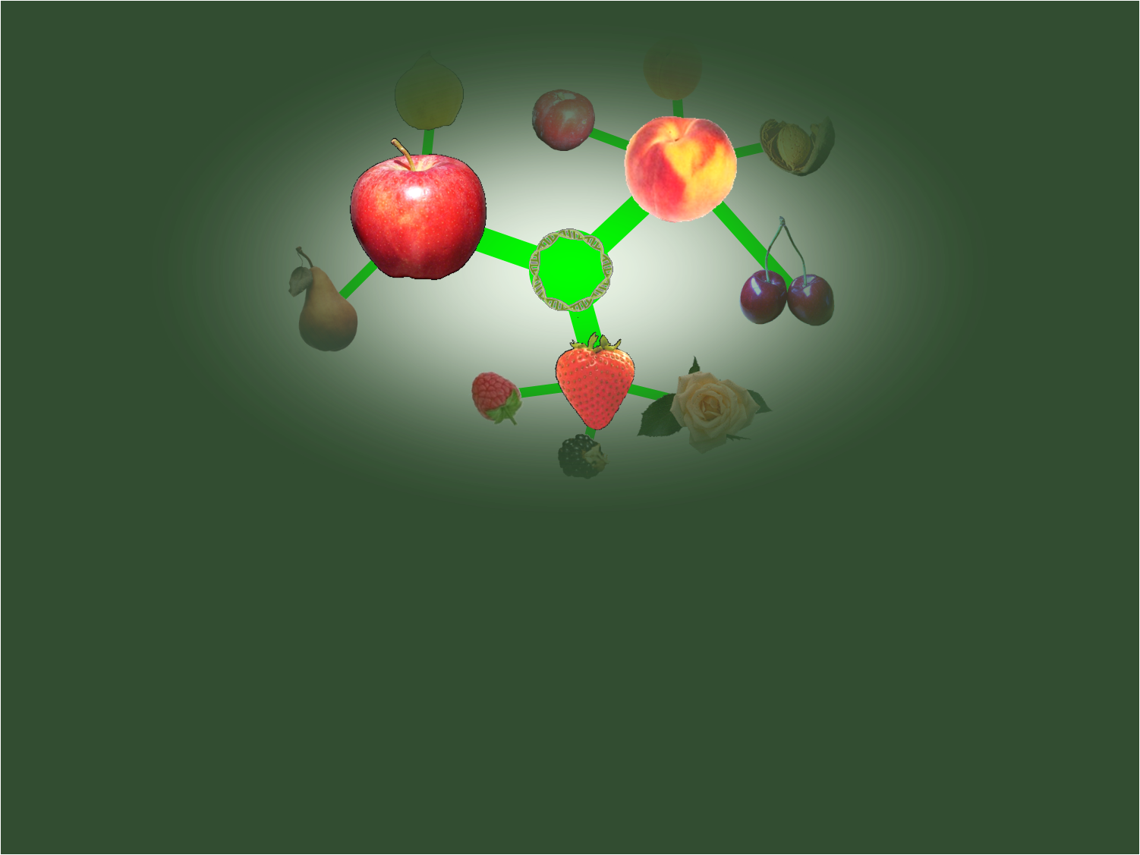
The RosBREED Project

Slide 4
The RosBREED Project
Goal: Enable MAB for U.S. Rosaceae crops
PI: Amy Iezzoni, Michigan State University
4 years, Sep 2009 – Aug 2013
Funded by SCRI (USDA-NIFA’s Specialty Crop Research Initiative)
$14.4 M ($7.2 M SCRI, $7.2 M in-kind Partners)
Collaboration U.S.-wide and international

Slide 5
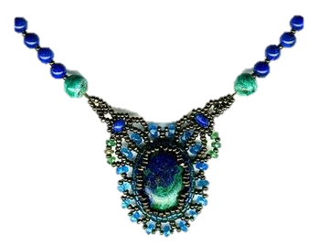
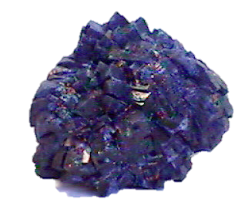
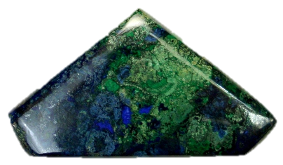
“Jewels in the Genome”
- discovering, polishing, using
QTL discovery (looks promising...)
MAB Pipelining (polishing...)
Breeding (assembling into masterpieces)
Jewels
= valuable genetic discoveries ready for breeding application
= marker-locus-trait associations validated in a breeding program

Slide 6
Application of Genomics Knowledge
Expression profiles
Find trait-controlling genes
Known QTLs
Linkage maps
Application in current cultivars
DNA information
Application
Genetic/allelic diversity
Application in breeding
Whole genome sequences
GMO

Slide 7
Application of Genomics Knowledge
Expression profiles
Find trait-controlling genes
Known QTLs
What DNA information is available?
Various ways to get there
What is the practical goal?
Linkage maps
Application in current cultivars
DNA information
Practical application
Genetic/allelic diversity
Application in breeding
Whole genome sequences
GMO

Slide 8
Application of Genomics Knowledge
Known QTLs
QTL priorities
DNA testing services
Breeding markers
Simple validation
Allele effects & distributions
Crossing schemes
Application in breeding
Seedling selection schemes
Trial MASS

Slide 9
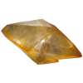
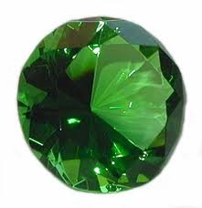
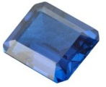
Application of Genomics Knowledge
Known QTLs
QTL priorities
DNA testing services
Breeding markers
Simple validation
Allele effects & distributions
Crossing schemes
Application in breeding
Seedling selection schemes
Trial MASS

Slide 10
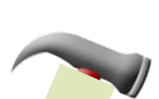
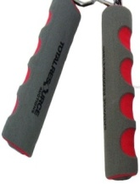
Application in Breeding - Requirements
Tool utility = predictive power in germplasm of a breeding program
Tool itself = assay (DNA markers) usable by a breeding program

Slide 11
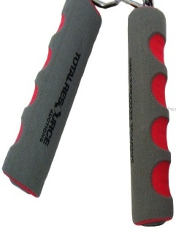
Application in Breeding - Requirements
Tool utility = predictive power in germplasm of a breeding program
Tool itself = assay (DNA markers) usable by a breeding program
→ready-to-use marker-locus-trait associations
DNA tests for contrasting alleles at loci for valuable traits

Slide 12
Application in Breeding - Requirements
Tool utility = predictive power in germplasm of a breeding program
Tool itself = assay (DNA markers) usable by a breeding program
Idiosyncratic!
One size does not fit all!
→ready-to-use marker-locus-trait associations
DNA tests for contrasting alleles at loci for valuable traits
...all breeding-program-specific

Slide 13
Available “Jewels in the Genome”

Slide 14
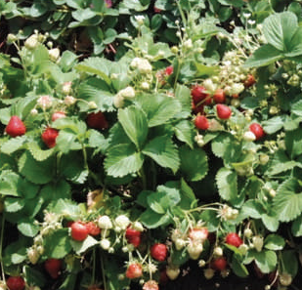
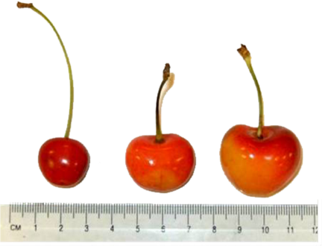
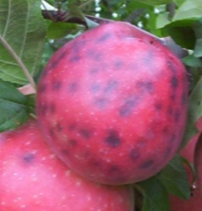
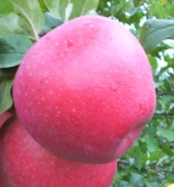
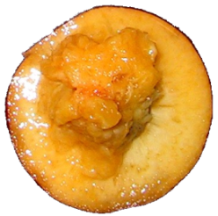
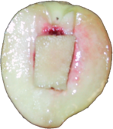
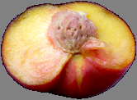
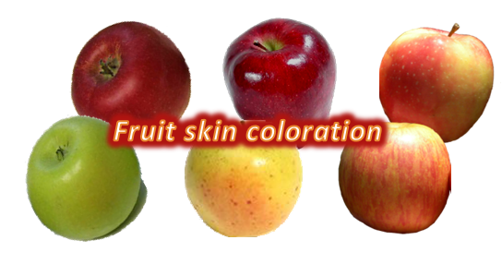
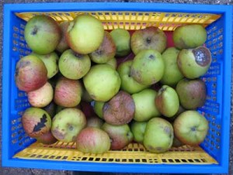
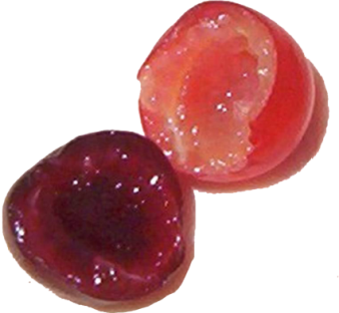
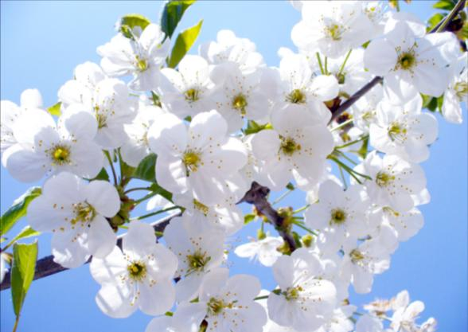
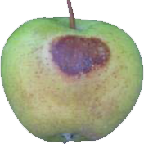
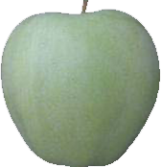
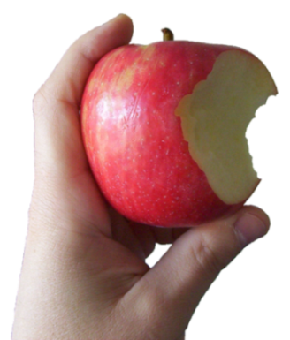
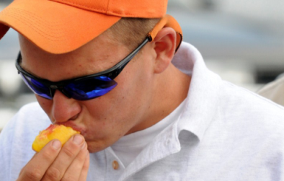
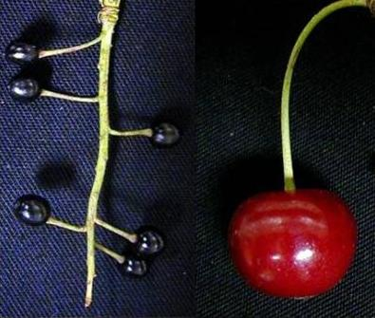
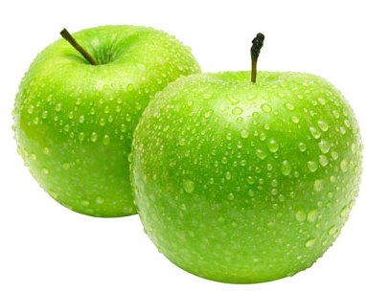
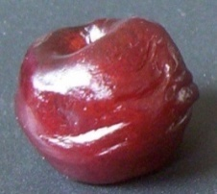
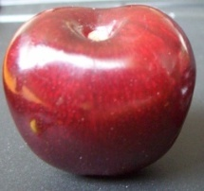
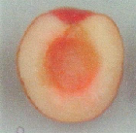
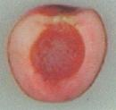
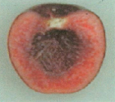
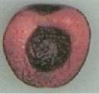
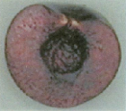
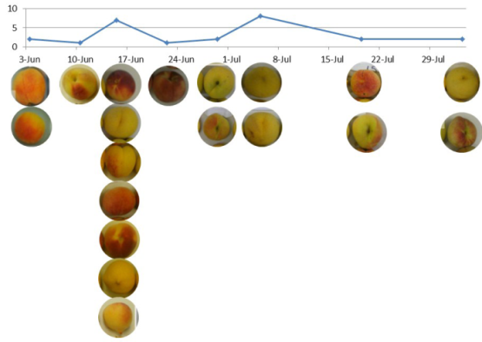
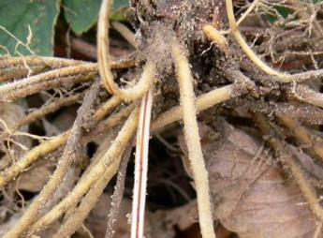
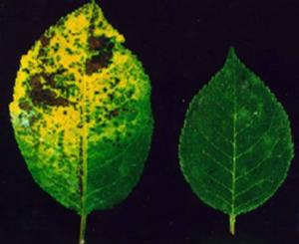
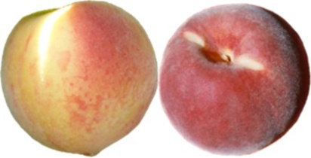
Available “Jewels in the Genome”
Fruit size
Freestone vs. clingstone
Ever-bearing
Bitter pit susceptibility
Melting vs. Non-melting flesh
Self-fertility
Fruit storability
Fruit color
Fruit size
“Fresh sensation” (crispness, tartness, juiciness)
Sunburn susceptibility
Sweetness & acidity
Firmness
Acidity
Fruit color
Maturity date
Red stele resistance
Leaf spot resistance
Fruit skin color

Slide 15
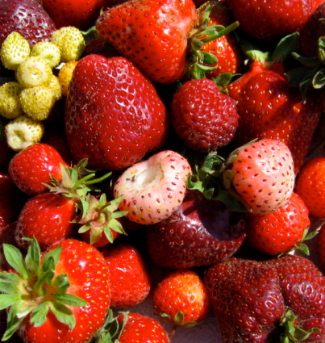
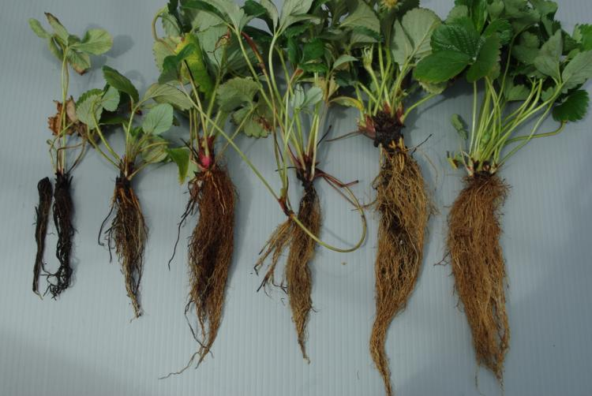
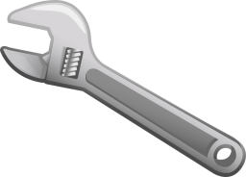
Strawberry: Red Stele Resistance
Red stele resistance
Is presence of certain SSR allele associated with red stele resistance?
Validation of marker by inoculations:
- 75% match genotype-phenotype - 20% individuals have other resistance sources
0 1 2 3 4 5
3.43 disease threshold
Genotypic data also used to identify many cases of incorrect parentage
Marker(s)? 1 SSR
Application? Parents: crossing Seedlings: culling Selections: advance

Slide 16
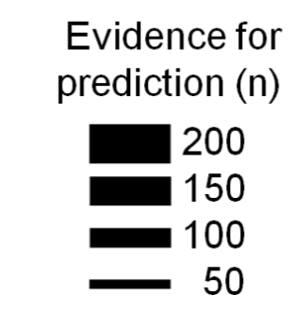
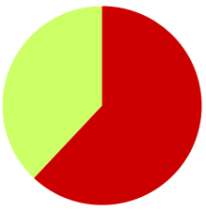
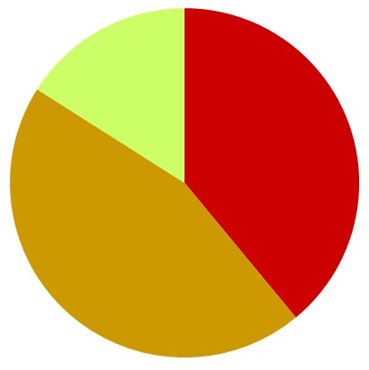
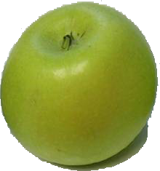
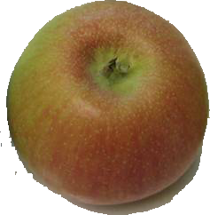
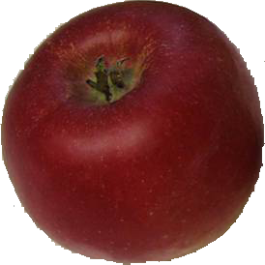
Apple: Skin Coloration
Allele & Genotype frequencies in 192 cvs
Cover amount over apple skin surface
rf
rfrf
Rf
RfRf
Rfrf
probability
1000 seedlings – how many with score >4?
Rfrf x RfRf ---> 647
RfRf x RfRf ---> 818
+26% efficiency!
Marker(s)? 1-3 SNPs from 8K array genome scan
Application? Parents: crossing Selections: distinguish Rfrf / RfRf

Slide 17
Peach: Maturity Date
Maturity date
One trait locus, two ways of genotyping
Three 2-SNP haplotypes (AA,GA,AG) in four combinations
Two SSR alleles (168,156) in two combinations
GA:AA
AA:AA
AA:AG
GA:AG
168:168
156:168
-40
-20
20 July
+20
+40 days
-40
-20
20 July
+20
+40 days
Marker(s)? 2 SNPs from 9K array ...or ... 1 SSR
Application? Parents: crossing Seedlings: culling Selections: advance

Slide 18
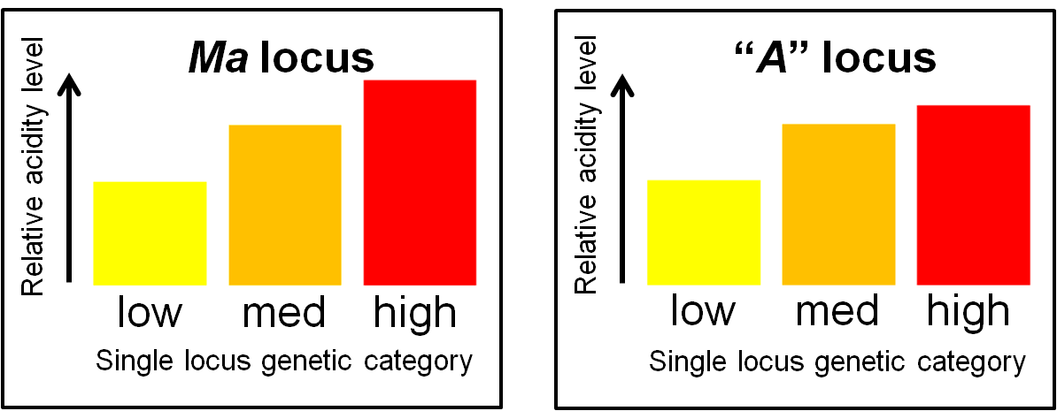
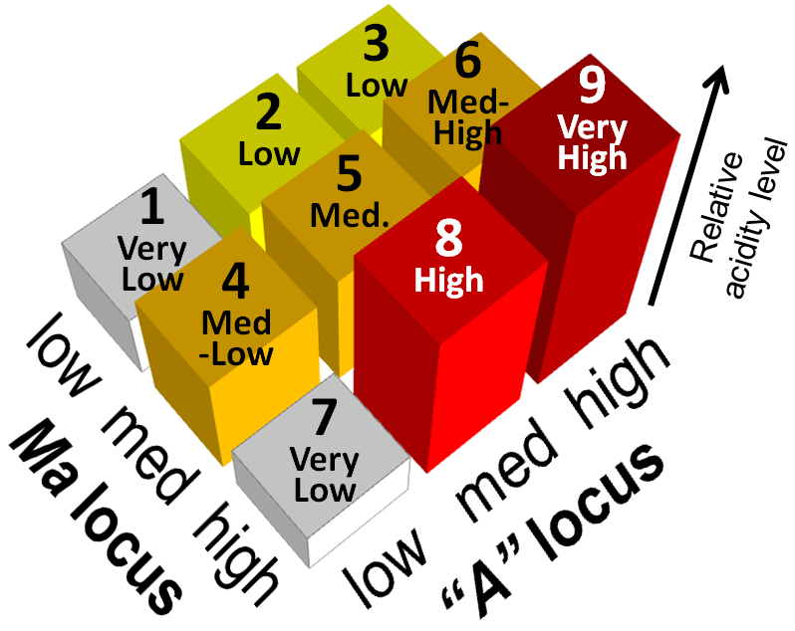
Apple: Acidity
Acidity
Two loci Ma – LG16 “A” – LG8
Not quite additive – some epistasis
→ Use together
Marker(s)? 2 SNPs from 8K array genome scan
Application? Parents: crossing Selections: distinguish low/med/high

Slide 19
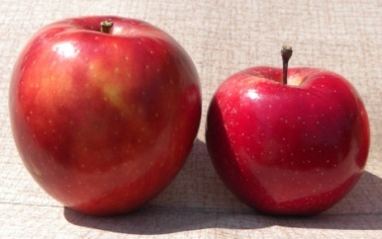
Apple: Multiple Traits Around Ma Locus
cM
Mb
16
“Fresh sensation” (crispness, tartness, juiciness)
0
0
5
Bitter pit susceptibility
Ma
2
Fruit size
10
15
4
Target B?
20
25
Maturity date
30
6
L
L
Every individual has 2 haplotypes
Honeycrisp
Golden Del.
Braeburn
Gala
Pink Lady
Target A?
L
E
L
L
L
L
Marker(s)? 1 SSR
Application? Parents: crossing Seedlings: culling Selections: advance

Slide 20
Cherry: G2 Fruit Size and Firmness – An Economic Trade-Off
Fruit size
Firmness
Socio-economic value ($ per lb)
G2 locus haplotype
G2 locus diplotype
0.10
L
BL AL
SE value
=
value of reaching threshold x probability of achieving it
0.08
CE
0.06
BE
E
0.04
C
A
AA
Population average
B
AB
AE
AD AC
D
0.02
H
BD
AH
F
AF
0
m
N O
Am AN BN Bm
Marker(s)? SSRs – 2 flanking the QTL
Application? Parents: crossing Seedlings: culling Selections: advance

Slide 21
Jewels in Breeding Application

Slide 22
Marker-Assisted Seedling Selection
in the Washington Apple Breeding Program
Fruit storability
“Fresh sensation” (crispness, tartness, juiciness)
Cost per initial seed
estimated projected resource savings
$10
2010
2011
2012
Savings
$62K
$38K
$60K
$8
Rearing & evaluating those kept
$6
seedlings tested
8000
5417
7452
$4
DNA testing
seedlings culled
$2
5000
2937
4403
Early rearing
$0

Slide 23
What’s Next? RosBREED 2

Slide 24
A Planned New RosBREED Project
CONSUMPTION
MARKETING
PROCESSING
PRODUCTION
Innovative, superior, risk-mitigating new cultivars
Cultivar commercialization
Post-breeding
Socio-economics information
Seedling selection
Parent selection
Efficient, accurate, creative breeding
Breeding
DNA information
Germplasm development
Accessible natural diversity
Pre-breeding
NATURAL DIVERSITY

Slide 25
Acknowledgements
This project is supported by the Specialty Crop Research Initiative of USDA’s National Institute of Food and Agriculture

Slide 26
Questions?

